Slide 1
Capstone Project 2019
IOS Team
Technical Presentation

Slide 2
Requirements Engineering

Slide 3
Constraints
Time
Experience
The Client
&
Domain Knowledge
Notes:
Issues Faced:
Scope of requirements changed a lot
Lack of domain experience made it difficult to fully grasp the requirements at the beginning
Different team members had different understanding of the requirements and it was difficult to bring everyone on the same page
Many functional requirements depended on the technical constraints. Due to the technical unknowns, it was also ambiguous whether some requirements should be considered or not
Studying the requirements revealed further unknowns, which were not communicated to the customer during the meeting. The team had to wait till the next meeting to clarify those and it created a delay in the progress of the work
Prioritizing the requirements due to time, experience and technical constraints was hard to tackle: internally prioritized list didn’t confirm with the customer’s prioritization. It also caused delay.

Slide 4
Methodology & Lessons Learned
Requirements Engineers
Team
Client
Notes:
Efforts to resolve:
Tried focusing on the requirements we were sure about to get started with the work
Scheduled customer meetings and internal meetings to discuss the requirements to check for ambiguities
Tried acting out the scenarios to get a real sense of application usage, to get a better idea of the requirements
Watched videos regarding farming to better understand the context of problem statement
Used simulated environments and different applications to understand the context of application usage
Carried the ambiguities to the next customer meeting for clarification
What could have been improved?
Communication with the customer could have been regulated, or made more open
Technical constraints that were blockers to some requirements should have been communicated early on
Prioritization of the requirements could have been done early on with all the constraints considered
Scope should have been kept small from the very start considering the constraints
People experienced in the context of usage should have been contacted if possible for better understanding

Slide 5
Project Management (Responsibilities)
Use cases
Requirements
Architecture
Prototyping
Use case prototyping
API
Development

Slide 6
Project Management (Methodologies)
AGILE
Sprint
Scrum
GITLAB
Ticket
Kanban
REPOSITORY
Branch
Wiki

Slide 7
Project Management (Flow)
Ticket
Topic
Acceptance Criteria
Workflow
Project Manager
Task distribution
Roles
Expertise
Responsible Person
Developers
Developer
Tester
Project Manager

Slide 8
Project Management (Tools)
Daily scrum
Documentation
Communication
Pair programming

Slide 9
Project Management (Improvements)
Gitlab
CI/CD
Tags
Communication
Scrum
Retrospective
Ticket
Story point
Estimation
Timesheet

Slide 10
Architecture

Slide 11
Architecture: Introduction
When designing CarPlay Apps we need to take into account these things:
1. Paid or Free Subscription
2. iOS Version (iOS 13.0+)
Dashboard Capabilities
Siri Intents and Shortcut App
3. Swift Version (Swift 5+)
4. Software Constraints
5. Software and Hardware Requirements

Slide 12


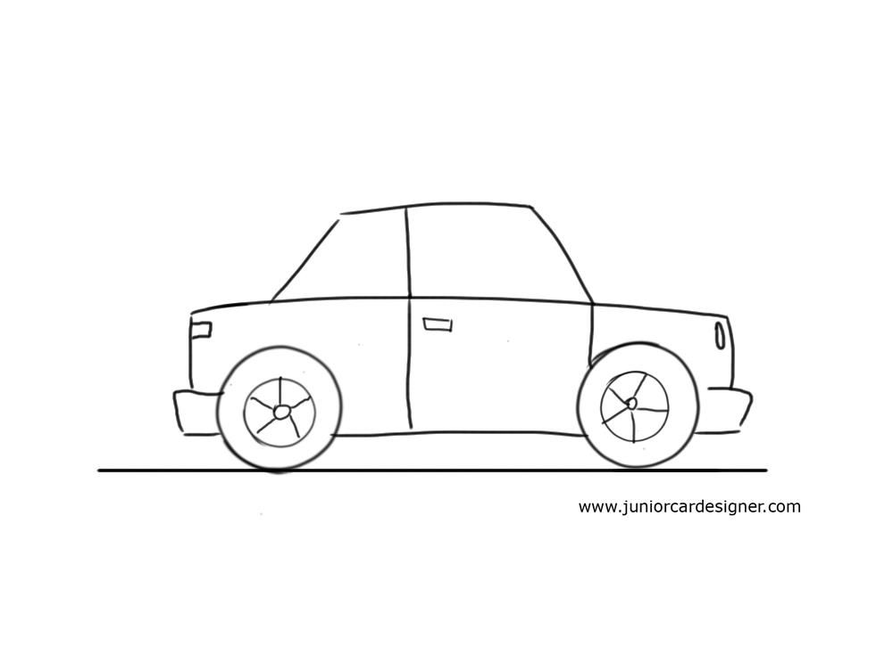


Architecture: Introduction
Swift Version
Subscription Type
Software Architect
IOS Car

Slide 13



Architecture: Application types
Voice and Messaging
Carmaker
Navigation
Playable Content
IOS Car

Slide 14
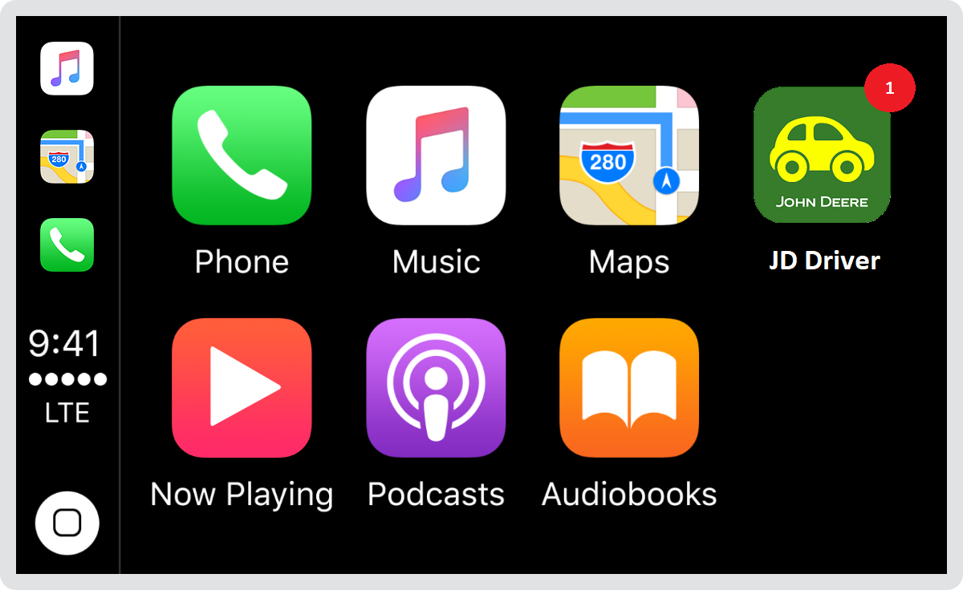
Architecture: Basic precautions
1. Badging​
2. Error Handling​
3. Loading​
4. Navigation​
5. Testing

Slide 15
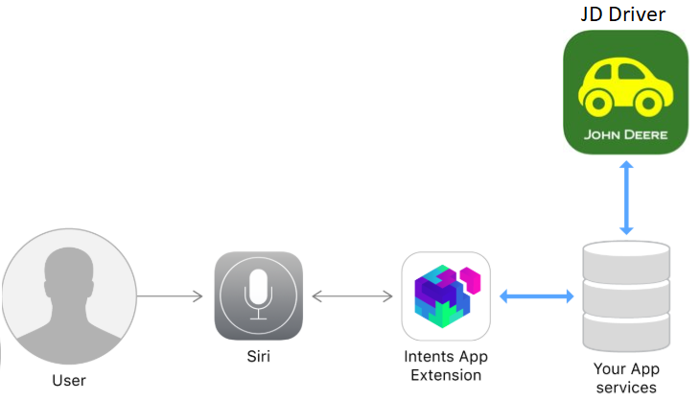
Architecture

Slide 16
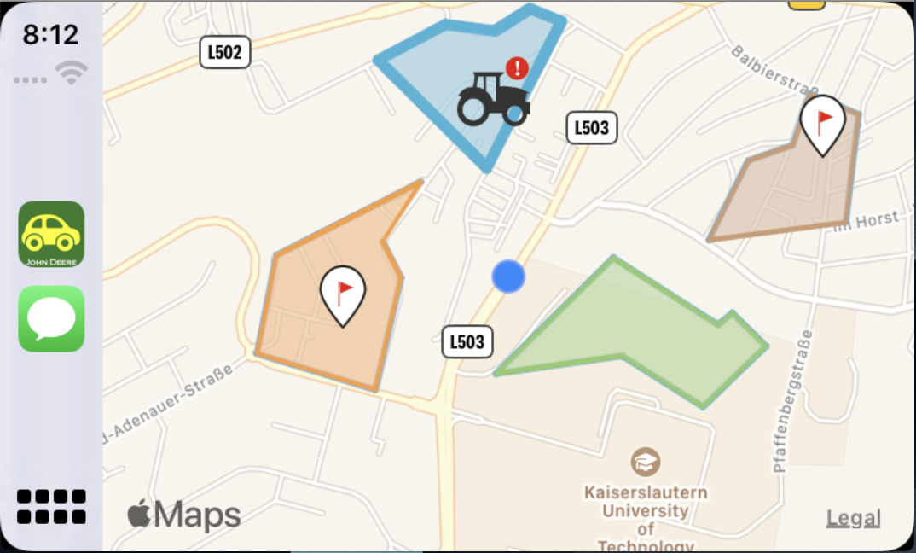


Architecture: JD Driver
iPhone
Carplay

Slide 17
Architecture: Layers
LaunchStoryboard
Storyboard
Xib
Front End
JohnDeere Controller
Scene Delegate
CarPlay Controller
Controllers
AppDelegate
Realm
CocoaPods
Back End

Slide 18
Architecture: Siri Intent
IntentsFile
Shortcut Donations
Shortcuts App
Front End
Machine Alert Handler
Fetch Updates Handler
Create Note Handler
Controllers
Machine Alert Target
Fetch Updates Target
Create Note Target
Siri Infrastructure
Targets

Slide 19
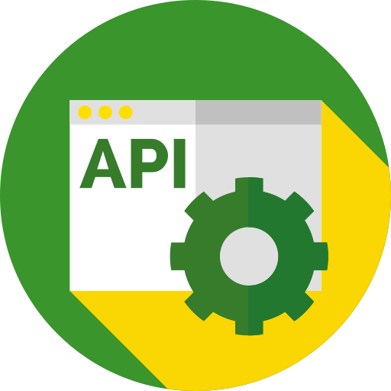
JD API Integration

Slide 20

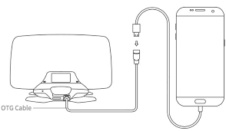
JD API Integration
JD API
JDOrganization
HTTP
JDField
...

Slide 21
JD API Integration: What we did?
Manual integration
JD Login
Show JDLogin screen and be able to authenticate
JD Framework
Framework in Objective-C is integrated into Swift app.
Alomofire for Swift
Could fetch data with existing token
JD Organizations
Fetch list of organizations and and list of fields within an organization

Slide 22
JD API Integration: Challenges
JD API Documentation (README.md)
Technical implementation issues

Slide 23
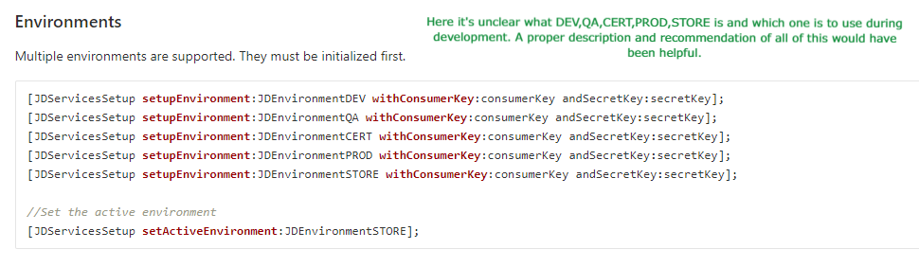
JD API Integration: Documentation issues

Slide 24
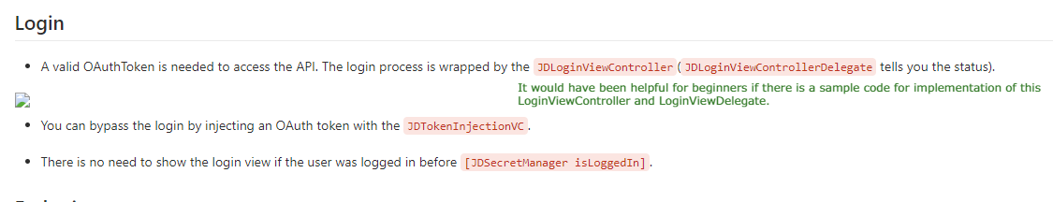
JD API Integration: Documentation issues

Slide 25
JD API Integration: Technical issues
JD Framework
In Objective-C
Skills
Nobody had Mobile Application development experience
Required bridging implementation
No prior knowledge of Swift

Slide 26
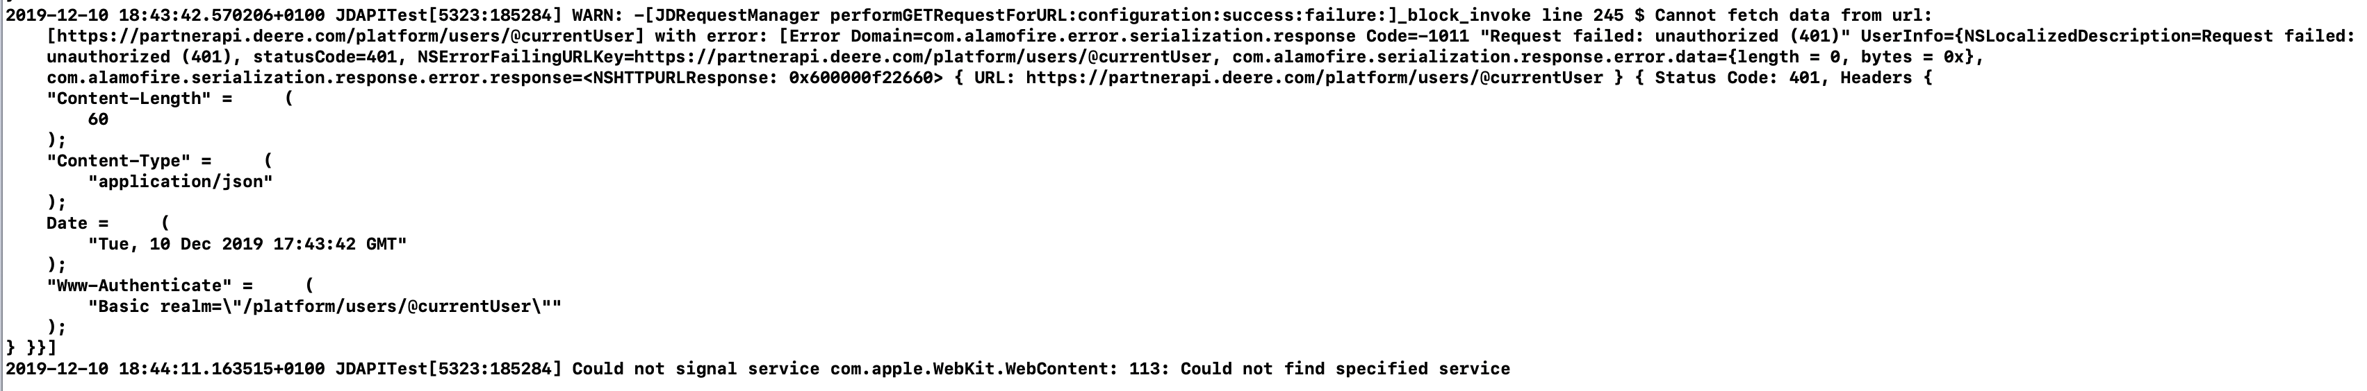
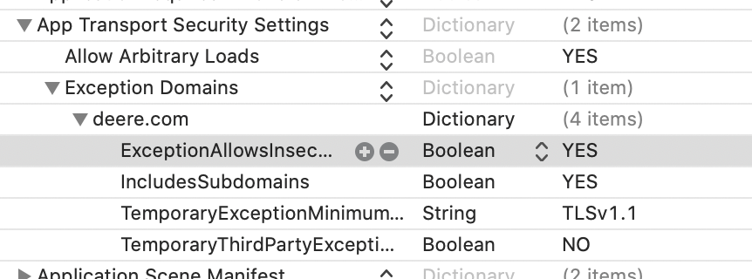
JD API Integration: Important Observations
JD Login
Default Storyboard must be deleted
JDLoginViewController initialized in SceneDelegate
Misleading Error messages
Probably bug of XCode

Slide 27
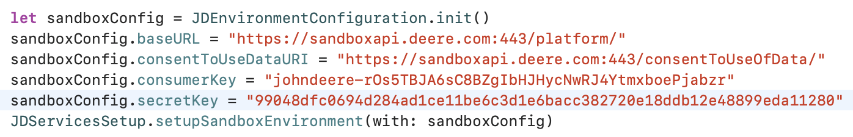
JD API Integration: Important Observations
JD fetch data
Inconsistency in workflow

Slide 28
Quality Assurance & Testing

Slide 29
Quality Assurance & Testing: Our Approaches
Functional Testing
Non-Functional Testing
Quality Assurance
Code Quality
Performance Testing

Slide 30
Quality Assurance & Testing: System Testing
Robustness
Security
Performance
Code Convention
Naming Convention
Reusability

Slide 31
Quality Assurance & Testing: Sample Test Case

Slide 32
Quality Assurance & Testing: Summary
Findings
Unit Testing
Difficulties
Environment
Pair programming
Time
Domain knowledge
80 % Success cases

